Slide 1
How to Escalate Tickets
For Tier 3 Support

Slide 2
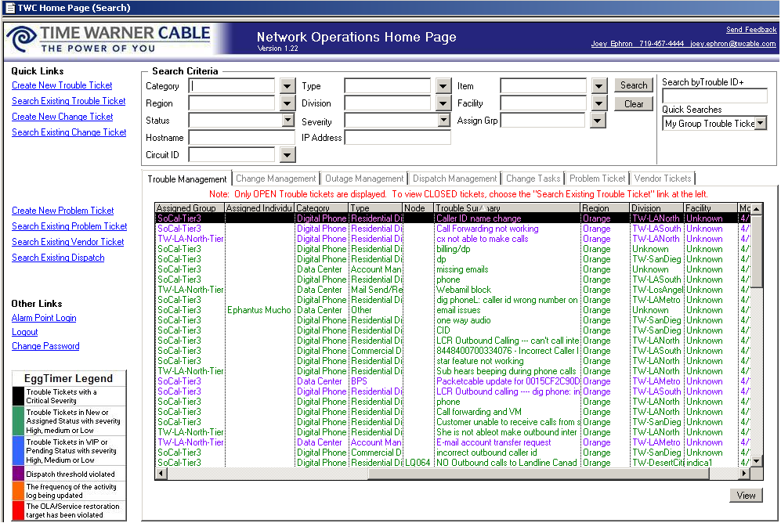
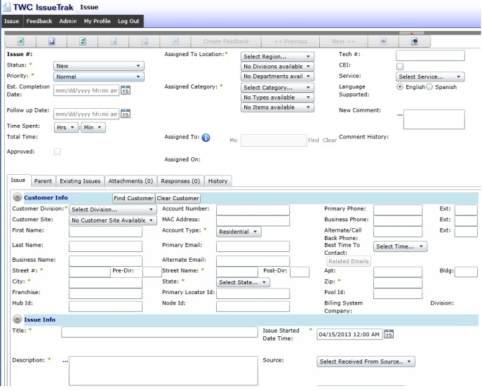
Methods of Ticket Creation
There are two ways to create an escalation ticket
ATG Remedy
IssueTrak
ATG Remedy is used for creating tickets for BPS (webjams and other e-mail related issues) and MailOPS tickets, for out-of-country customers not able to access their e-mail or getting limited functionality from e-mail
IssueTrak is used for creating tickets for Voice-Ops (GNOC) and CSD (Corporate Support Desk) escalations:
GNOC (Voice-Ops) tickets for phone problem like:
International calling issues
* Code issues
Incorrect Caller ID issues
CSD (Corporate Support Desk) tickets for app issues like:
MyServices account creation/management issues
VoiceZone Connect issues
TWCTV &TWCTV.com issues

Slide 3
Escalating from Remedy

Slide 4
Escalating from Remedy
This is the main screen of Remedy. Click on “Create New Trouble Ticket” to start a new ticket.

Slide 5
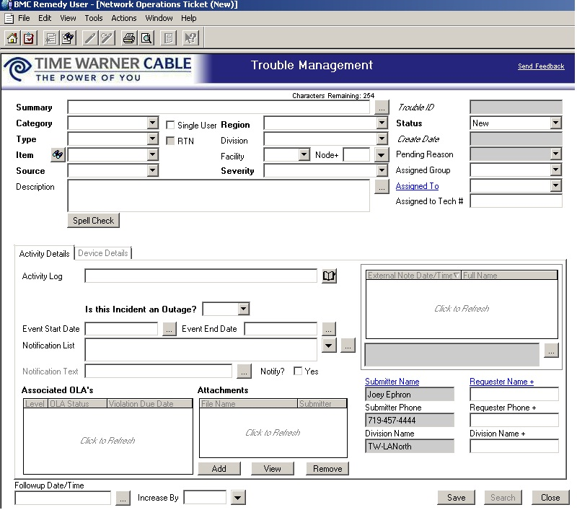
Escalating from Remedy
Use the “Summary” field to give a brief explanation of your issue

Slide 6
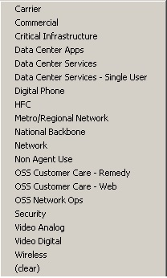
Escalating from Remedy
Choose the appropriate “Category”. Data Center Services is for BPS/E-mail, Data Center Services is for IP block (exc e-mail) problems and Digital Phone is for GNOC (only used if manually creating a ticket here instead of using IssueTrak).

Slide 7
Escalating from Remedy
“Type” will be the sub-info for the category; the more specific set of information relating to the customer’s issue.

Slide 8
Escalating from Remedy
“Item” is the exact problem. If the item for which you are escalating is not listed, check first to make sure proper troubleshooting was done and, if so, choose the closest item.

Slide 9
Escalating from Remedy
“Source” is always “Tier 3”

Slide 10
Escalating from Remedy
The issue should be fully notated in “Description”. There will be more info in the flowing slides describing exactly what information needs to be included for various issues.

Slide 11
Escalating from Remedy
“Region” is always “Orange”

Slide 12
Escalating from Remedy
“Severity” is generally going to be “Low”.

Slide 13
Escalating from Remedy
“Status” will be “New” on all tickets. The rest of the information in this area should auto-populate.

Slide 14
Escalating from Remedy
“Status” will be “New” on all tickets. The rest of the information in this area should auto-populate.
“Type” will be the sub-info for the category; the more specific set of information relating to the customer’s issue.
“Item” is the exact problem. If the item for which you are escalating is not listed, check first to make sure proper troubleshooting was done and, if so, choose the closes item.
“Region” is always “Orange”
“Severity” is generally going to be “Low”.
“Source” is always “Tier 3”
The issue should be fully notated in “Description”. There will be more info in the flowing slides describing exactly what information needs to be included for various issues.

Slide 15
Escalating from Remedy
Copy the text you put in “Description” into “Activity Log”

Slide 16
Escalating from Remedy
Answer the question “Is this Incident an Outage?” with the correct answer.

Slide 17
Escalating from Remedy
Click “Save”

Slide 18
Escalating Phone Issues
Escalating to assigned group DPED
Category: Digital Phone
Type:
Residential Digital Phone Services – If the problem involves making or receiving calls (other than call forwarding)
Residential Digital Phone Features – If the customer is able to make and receive calls fine, but can not use phone features such as * codes
Item: You will select the option that best describes the customer digital phone problem.
Source: Phone

